Slide 1


DEPARTEMEN SISTEM INFORMASI
Fak. Teknologi Elektro & Informatika Cerdas
IW184301
DATABASE SYSTEMS
Chapter 4-2
Enhanced Entity Relationship Modeling
Prof. Ir. Arif Djunaidy, M.Sc., Ph.D.
adjunaidy@is.its.ac.id
adjunaidy@gmail.com

Slide 2
Learning Objectives & Book Reading
Learning Objectives - To Understand:
How the ER model can be enhanced to include these concepts, leading to the Enhanced ER (EER) model
How the concepts of class/subclass relationships and type inheritance as well as the concepts of specialization and generalization can be incorporated into the ER model
How the UNION construct can be modeled by including the concept of category in the EER model
Book reading:
Elmasri, Chapter 8
EER Modeling
2
Chapter 04-2 / 2

Slide 3
Outline
EER stands for Enhanced ER or Extended ER
EER Model Concepts
Includes all modeling concepts of basic ER
Additional concepts:
subclasses/superclasses
specialization/generalization
categories (UNION types)
attribute and relationship inheritance
These are fundamental to conceptual modeling
The additional EER concepts are used to model applications more completely and more accurately
EER includes some object-oriented concepts, such as inheritance
EER Modeling
3
Chapter 04-2 / 3

Slide 4
Subclasses and Superclasses (1)
An entity type may have additional meaningful subgroupings of its entities
Example: EMPLOYEE may be further grouped into:
SECRETARY, ENGINEER, TECHNICIAN, …
Based on the EMPLOYEE’s Job
MANAGER
EMPLOYEEs who are managers
SALARIED_EMPLOYEE, HOURLY_EMPLOYEE
Based on the EMPLOYEE’s method of pay
EER diagrams extend ER diagrams to represent these additional subgroupings, called subclasses or subtypes
EER Modeling
Chapter 04-2 / 4

Slide 5
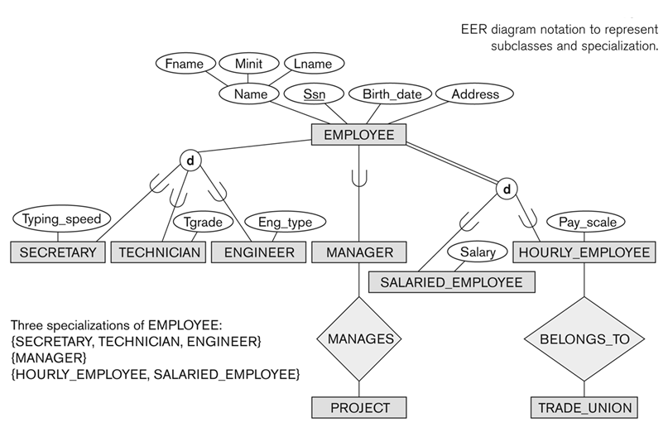
Subclasses and Superclasses (2) (2)
EER Modeling
Chapter 04-2 / 5

Slide 6
Subclasses and Superclasses (3)
Each of these subgroupings is a subset of EMPLOYEE entities
Each is called a subclass of EMPLOYEE
EMPLOYEE is the superclass for each of these subclasses
These are called superclass/subclass relationships:
EMPLOYEE/SECRETARY
EMPLOYEE/TECHNICIAN
EMPLOYEE/MANAGER
…
EER Modeling
Chapter 04-2 / 6

Slide 7
Subclasses and Superclasses (4)
These are also called IS-A relationships
SECRETARY IS-A EMPLOYEE, TECHNICIAN IS-A EMPLOYEE, ….
Note: An entity that is member of a subclass represents the same real-world entity as some member of the superclass:
The subclass member is the same entity in a distinct specific role
An entity cannot exist in the database merely by being a member of a subclass; it must also be a member of the superclass
A member of the superclass can be optionally included as a member of any number of its subclasses
EER Modeling
Chapter 04-2 / 7

Slide 8
Subclasses and Superclasses (5)
Examples:
A salaried employee who is also an engineer belongs to the two subclasses:
ENGINEER, and
SALARIED_EMPLOYEE
A salaried employee who is also an engineering manager belongs to the three subclasses:
MANAGER,
ENGINEER, and
SALARIED_EMPLOYEE
It is not necessary that every entity in a superclass be a member of some subclass
EER Modeling
Chapter 04-2 / 8

Slide 9
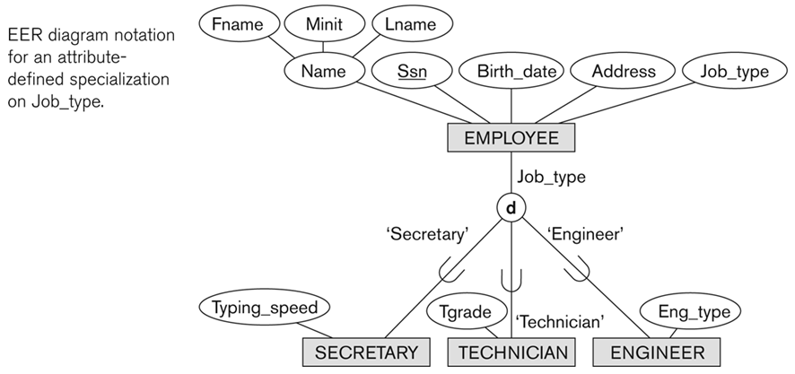
Representing Specialization in EER Diagrams
EER Modeling
Chapter 04-2 / 9

Slide 10
Attribute Inheritance in Superclass/Subclass Relationships
An entity that is member of a subclass inherits
All attributes of the entity as a member of the superclass
All relationships of the entity as a member of the superclass
Example:
In the previous slide, SECRETARY (as well as TECHNICIAN and ENGINEER) inherit the attributes Name, SSN, …, from EMPLOYEE
Every SECRETARY entity will have values for the inherited attributes
EER Modeling
Chapter 04-2 / 10

Slide 11
Specialization (1)
Specialization is the process of defining a set of subclasses of a superclass
The set of subclasses is based upon some distinguishing characteristics of the entities in the superclass
Example: {SECRETARY, ENGINEER, TECHNICIAN} is a specialization of EMPLOYEE based upon job type.
May have several specializations of the same superclass
EER Modeling
Chapter 04-2 / 11

Slide 12
Specialization (2)
Example: Another specialization of EMPLOYEE based on method of pay is {SALARIED_EMPLOYEE, HOURLY_EMPLOYEE}.
Superclass/subclass relationships and specialization can be diagrammatically represented in EER diagrams
Attributes of a subclass are called specific or local attributes.
For example, the attribute TypingSpeed of SECRETARY
The subclass can also participate in specific relationship types.
For example, a relationship BELONGS_TO of HOURLY_EMPLOYEE
EER Modeling
Chapter 04-2 / 12

Slide 13
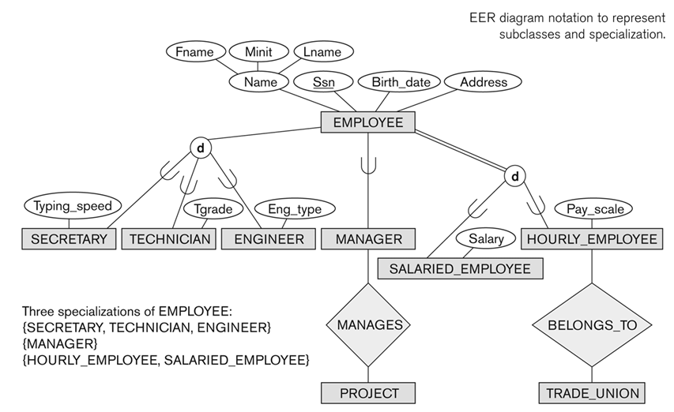
Specialization (3)
EER Modeling
Chapter 04-2 / 13

Slide 14
Generalization (1)
Generalization is the reverse of the specialization process
Several classes with common features are generalized into a superclass;
original classes become its subclasses
Example: CAR, TRUCK generalized into VEHICLE;
both CAR, TRUCK become subclasses of the superclass VEHICLE.
We can view {CAR, TRUCK} as a specialization of VEHICLE
Alternatively, we can view VEHICLE as a generalization of CAR and TRUCK
EER Modeling
Chapter 04-2 / 14

Slide 15
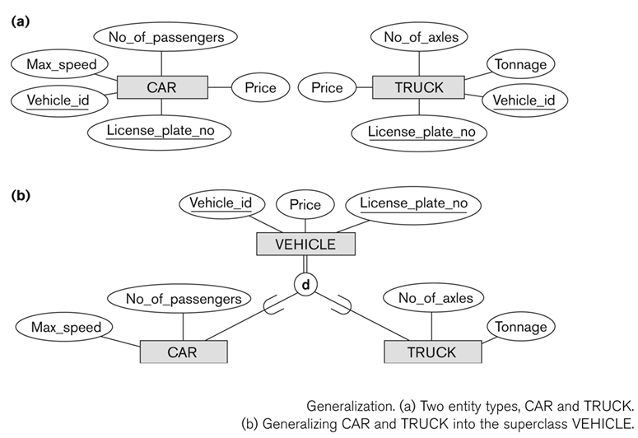
Generalization (2)
EER Modeling
Chapter 04-2 / 15

Slide 16
Generalization and Specialization (2)
Data Modeling with Specialization and Generalization
A superclass or subclass represents a collection (or set or grouping) of entities
It also represents a particular type of entity
Shown in rectangles in EER diagrams (as are entity types)
We can call all entity types (and their corresponding collections) classes, whether they are entity types, superclasses, or subclasses
EER Modeling
Chapter 04-2 / 16

Slide 17
Constraints on Specialization and Generalization (1)
If we can determine exactly those entities that will become members of each subclass by a condition, the subclasses are called predicate-defined (or condition-defined) subclasses
Condition is a constraint that determines subclass members
Display a predicate-defined subclass by writing the predicate condition next to the line attaching the subclass to its superclass
EER Modeling
Chapter 04-2 / 17

Slide 18
Constraints on Specialization and Generalization (2)
If all subclasses in a specialization have membership condition on same attribute of the superclass, specialization is called an attribute-defined specialization
Attribute is called the defining attribute of the specialization
Example: JobType is the defining attribute of the specialization {SECRETARY, TECHNICIAN, ENGINEER} of EMPLOYEE
If no condition determines membership, the subclass is called user-defined
Membership in a subclass is determined by the database users by applying an operation to add an entity to the subclass
Membership in the subclass is specified individually for each entity in the superclass by the user
EER Modeling
Chapter 04-2 / 18

Slide 19
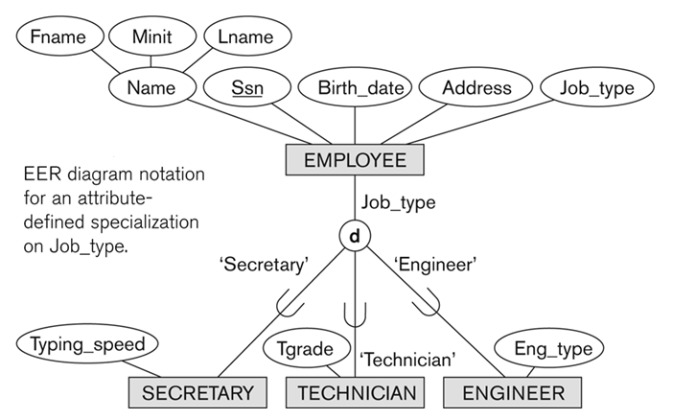


Displaying an attribute-defined specialization in EER diagrams
EER Modeling
Chapter 04-2 / 19

Slide 20
Constraints on Specialization and Generalization (3)
Two basic constraints can apply to a specialization/generalization:
Disjointness Constraint:
Completeness Constraint:
EER Modeling
Chapter 04-2 / 20

Slide 21
Constraints on Specialization and Generalization (4)
Disjointness Constraint:
Specifies that the subclasses of the specialization must be disjoint:
an entity can be a member of at most one of the subclasses of the specialization
Specified by d in EER diagram
If not disjoint, specialization is overlapping:
that is the same entity may be a member of more than one subclass of the specialization
Specified by o in EER diagram
EER Modeling
Chapter 04-2 / 21

Slide 22
Constraints on Specialization and Generalization (5)
Completeness Constraint:
Total specifies that every entity in the superclass must be a member of some subclass in the specialization/generalization
Shown in EER diagrams by a double line
Partial allows an entity not to belong to any of the subclasses
Shown in EER diagrams by a single line
EER Modeling
Chapter 04-2 / 22

Slide 23
Constraints on Specialization and Generalization (6)
Hence, we have four types of specialization/generalization:
Disjoint, total
Disjoint, partial
Overlapping, total
Overlapping, partial
Note: Generalization usually is total because the superclass is derived from the subclasses.
EER Modeling
Chapter 04-2 / 23

Slide 24
Example of disjoint partial Specialization
EER Modeling
Chapter 04-2 / 24

Slide 25
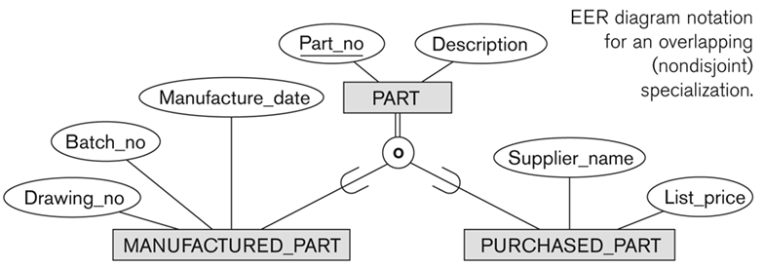
Example of overlapping total Specialization
EER Modeling
Chapter 04-2 / 25

Slide 26
Specialization/Generalization Hierarchies, Lattices & Shared Subclasses (1)
A subclass may itself have further subclasses specified on it
forms a hierarchy or a lattice
Hierarchy has a constraint that every subclass has only one superclass (called single inheritance); this is basically a tree structure
In a lattice, a subclass can be subclass of more than one superclass (called multiple inheritance)
EER Modeling
Chapter 04-2 / 26

Slide 27
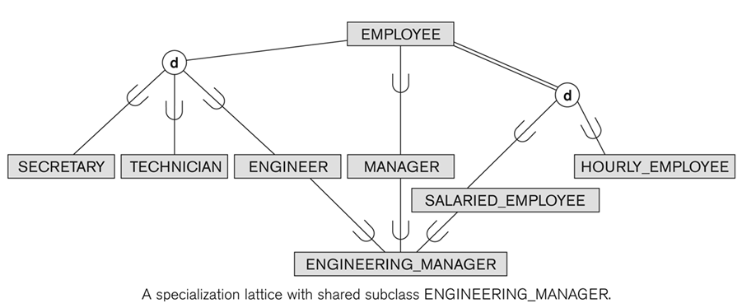
Shared Subclass “Engineering_Manager”
EER Modeling
Chapter 04-2 / 27

Slide 28
Specialization/Generalization Hierarchies, Lattices & Shared Subclasses (2)
In a lattice or hierarchy, a subclass inherits attributes not only of its direct superclass, but also of all its predecessor superclasses
A subclass with more than one superclass is called a shared subclass (multiple inheritance)
Can have:
specialization hierarchies or lattices, or
generalization hierarchies or lattices,
depending on how they were derived
We just use specialization (to stand for the end result of either specialization or generalization)
EER Modeling
Chapter 04-2 / 28

Slide 29
Specialization/Generalization Hierarchies, Lattices & Shared Subclasses (3)
In specialization, start with an entity type and then define subclasses of the entity type by successive specialization
called a top down conceptual refinement process
In generalization, start with many entity types and generalize those that have common properties
Called a bottom up conceptual synthesis process
In practice, a combination of both processes is usually employed
EER Modeling
Chapter 04-2 / 29

Slide 30
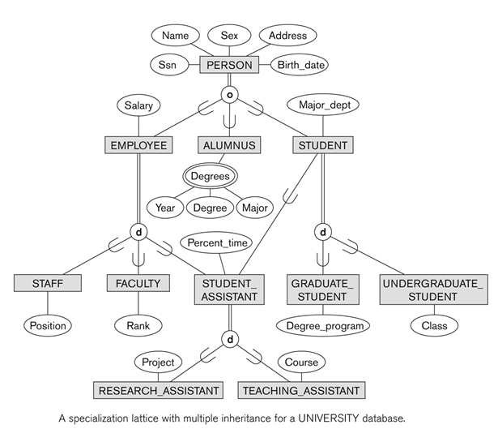
Specialization / Generalization Lattice Example (UNIVERSITY)
EER Modeling
Chapter 04-2 / 30

Slide 31
Categories (UNION TYPES) (1)
All of the superclass/subclass relationships we have seen thus far have a single superclass
A shared subclass is a subclass in:
more than one distinct superclass/subclass relationships
each relationships has a single superclass
shared subclass leads to multiple inheritance
In some cases, we need to model a single superclass/subclass relationship with more than one superclass
Superclasses can represent different entity types
Such a subclass is called a category or UNION TYPE
EER Modeling
Chapter 04-2 / 31

Slide 32
Categories (UNION TYPES) (2)
Example: In a database for vehicle registration, a vehicle owner can be a PERSON, a BANK (holding a lien on a vehicle) or a COMPANY.
A category (UNION type) called OWNER is created to represent a subset of the union of the three superclasses COMPANY, BANK, and PERSON
A category member must exist in at least one of its superclasses
Difference from shared subclass, which is a:
subset of the intersection of its superclasses
shared subclass member must exist in all of its superclasses
EER Modeling
Chapter 04-2 / 32

Slide 33
Two categories (UNION types): OWNER, REGISTERED_VEHICLE
EER Modeling
Chapter 04-2 / 33

Slide 34
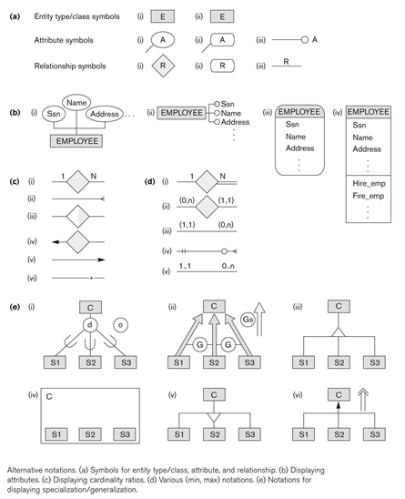
Alternative Diagrammatic Notations
EER Modeling
Chapter 04-2 / 34

Slide 35
Aggregation
Aggregation is an abstraction concept for building composite objects from their component objects
The EER model does not provide for explicitly, involves the possibility of combining objects that are related by a particular relationship instance into a higher-level aggregate object.
➔ This is sometimes useful when the higher-level aggregate object is itself to be related to another object
EER Modeling
Chapter 04-2 / 35

Slide 36
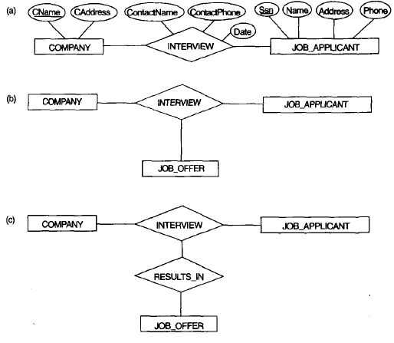
Aggregation: Example (1)
The relationship type INTERVIEW
(b) Including JOB_OFFER in a ternary relationship type incorrect)
(c) Having the RESULTS_IN participatein other relationships (generally not allowed in ER).
EER Modeling
Chapter 04-2 / 36

Slide 37
Aggregation: Example (2)
(d) Correct representation in ER aggregating of attribute values of an object to form the whole objerct
(e) Correct representation in Chen model (using associatve entity)
(e)
EER Modeling
Chapter 04-2 / 37

Slide 38
In-class Exercise
Consider an ONLINE_AUCTION database system in which members (buyers and sellers) participate in the sale of items. Design an ER/EER diagram for this ONLINE_AUCTION database. The data requirements for this system are summarized as follows:
The online site has members, each of whom is identified by a unique member number and is described by an e-mail address, name, password, home address, and phone number.
A member may be a buyer or a seller. A buyer has a shipping address recorded in the database. A seller has a bank account number and routing number recorded in the database.
Items are placed by a seller for sale and are identified by a unique item number assigned by the system. Items are also described by an item title, a description, starting bid price, bidding increment, the start date of the auction, and the end date of the auction.
Items are also categorized based on a fixed classification hierarchy (for example, a modem may be classified as COMPUTER → HARDWARE → MODEM).
Buyers make bids for items they are interested in. Bid price and time of bid is recorded. The bidder at the end of the auction with the highest bid price is declared the winner and a transaction between buyer and seller may then proceed.
The buyer and seller may record feedback regarding their completed transactions. Feedback contains a rating of the other party participating in the transaction (1–10) and a comment.
EER Modeling
Chapter 04-2 / 38

Slide 39

End of Chapter 4-2

